Slide 1
Project Management: Project Planning
Dr. Adebiyi A.A.

Slide 2
Project Initiation and Planning
Information system development projects are initiated for various reasons. Three general driving forces are as follows: (1) to respond to an opportunity, (2) to resolve a problem, and (3) to conform to a directive.
planning is an optimal way to identify new projects.
As the strategic plans are developed, projects are identified, prioritized, and scheduled.
Projects initiated through strategic planning are sometimes described as top-down projects.

Slide 3
Project Initiation and Planning Cont.
To prioritize these projects, companies use a technique called weighted scoring. First, the IT strategic planning committee identifies a set of criteria to judge the importance of new projects.
Examples of criteria are “opens a new market” or “provides a high net present value.” These criteria are weighted for their importance, and each potential project is rated according to the set of criteria. Projects with the highest scores are given priority for initiation.

Slide 4
Project planning activities
Predictive and adaptive projects begin with overall project planning.
The major difference in planning between the two types of projects is the level of detail provided.
Predictive project members attempt to plan the entire project, including the schedule, at a fairly detailed level.
Adaptive project members plan the overall project, but leave much of the detail to be developed during iteration planning.

Slide 5
Project planning activities cont’d
Project planning activities are as follows:
Define the problem.
Produce the project schedule.
Confirm project feasibility.
Staff the project.
Launch the project.

Slide 6
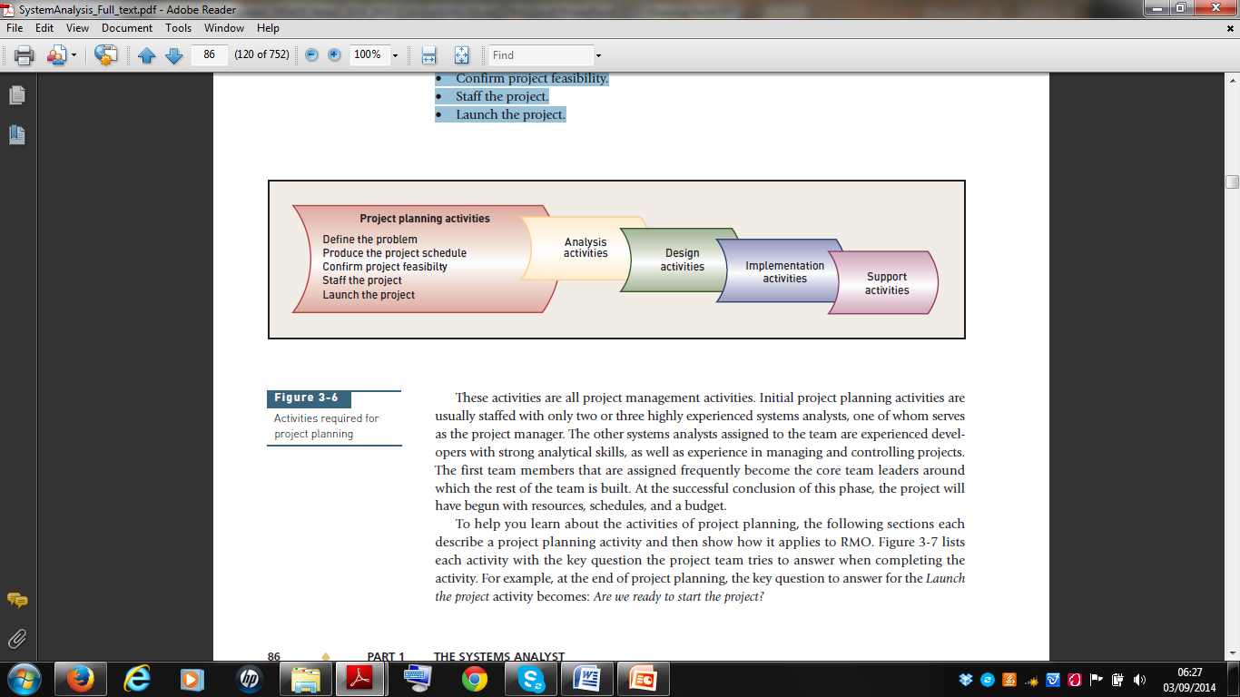
Figure 1: Activities require for project planning

Slide 7
Project planning activities cont’d
Figure 2 lists each activity with the key question the project team tries to answer when completing the activity.
For example, at the end of project planning, the key question to answer for the Launch of the project activity becomes: Are we ready to start the project?

Slide 8
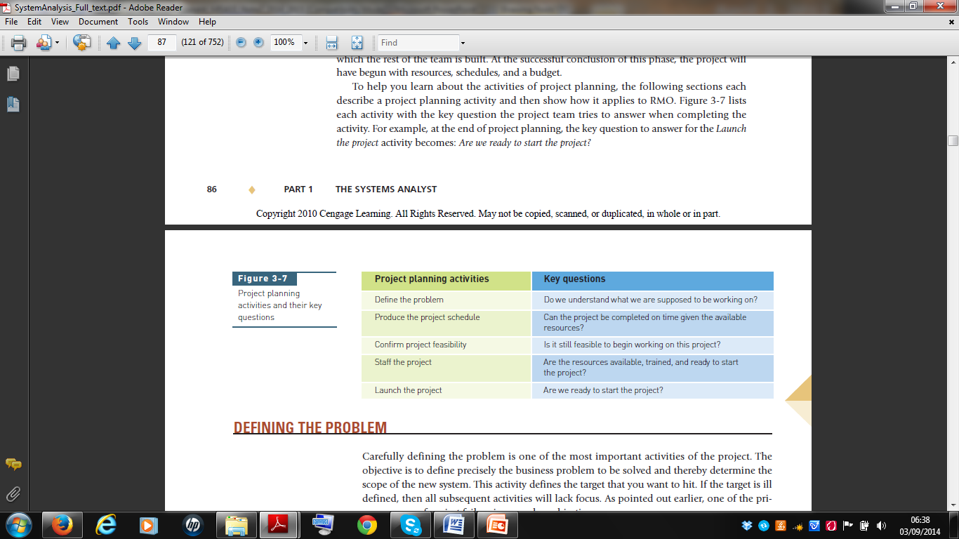
Figure 2: Project planning activities and their key questions

Slide 9
Defining the problem
Carefully defining the problem is one of the most important activities of the project. The objective is to define precisely the business problem to be solved and thereby determine the scope of the new system.
This activity defines the target that you want to hit. If the target is ill defined, then all subsequent activities will lack focus. As pointed out earlier, one of the primary causes of project failure is an unclear objective.

Slide 10
Defining the problem cont.
The first task within this activity is to review the business needs that originally initiated the project.
As the needs are identified, the team also develops a detailed list of the expected benefits. We define those as the business benefits.
The list of business benefits contains the results that the organization anticipates it will accrue from a new system. Business benefits are normally described in terms of the influences that can change the financial statements, either by decreasing costs or increasing revenues.

Slide 11
Defining the problem cont.
The second task in this activity is to identify, at a high level, the expected capabilities of the new system. The objective is to define the scope of the problem in terms of the requirements of the information system that can solve the problem.
Members of the development team combine these three components—the problem description, the business benefits, and the system capabilities—to get a system scope document.

Slide 12
Defining the problem cont.
System scope document - a document containing problem description, business benefits, and system capabilities to help define the scope of a new system.
The business benefits focus on the financial benefit to the company. The system capabilities focus on the system itself. The benefits are achieved through the capabilities provided by the system.

Slide 13
Defining the problem cont.
Figure 3 is example of system scope document.
New solutions, particularly those based on new technology, may not be well accepted or well understood. In that situation, the project team can build a proof of concept prototype to illustrate that a solution is possible and feasible.
Proof of concept prototype - a very preliminary prototype built to illustrate that a solution to a business need is feasible.
Figure 4 is an example of a simplified data flow diagram (DFD) called the context diagram for the RMO customer support system.

Slide 14
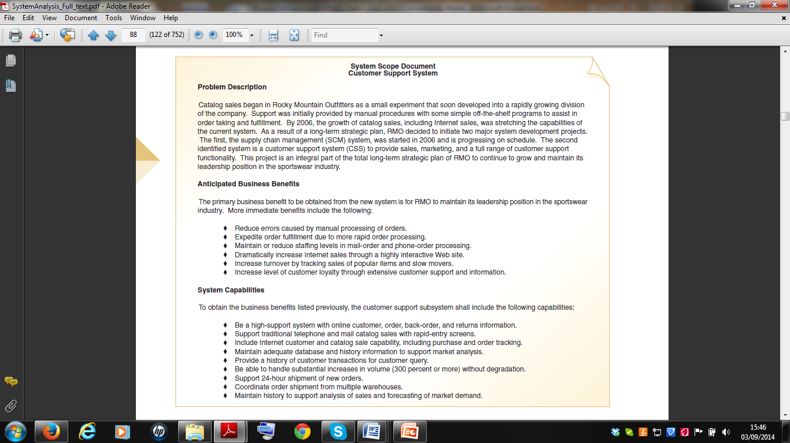
Figure 3: System scope document for the RMO customer support system

Slide 15
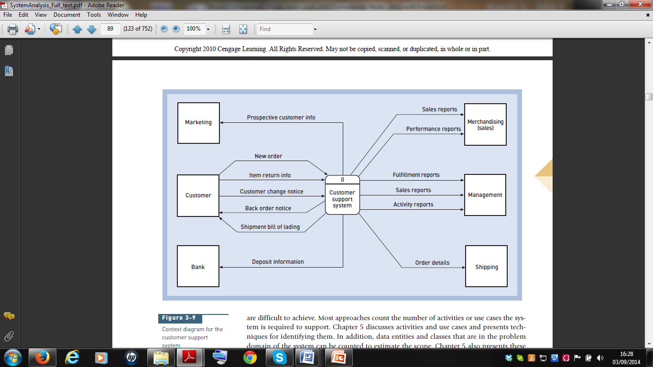
Figure 4: Context diagram for the customer support system

Slide 16
Defining the problem cont.
During project planning, the diagram helps define the scope of the problem. This diagram becomes a starting point for the more detailed investigation done during analysis.
The size or scope of the system determines the amount of effort, which then determines the time and cost of the project. Several techniques can be used to measure the size or scope of a proposed system.
One technique, called the COnstructive COst MOdel (COCOMO), attempts to count function points as the number of inputs and outputs, the number of files maintained, the number of updates required, and so on.
The key question to be answered when completing the problem definition activity is: Do we understand what we are supposed to be working on?

Slide 17
Producing the project schedule
Before discussing the details of a project schedule, let’s clarify two terms: task and activity.
Fundamentally, an activity is made up of a group of related tasks or other smaller activities. A task, then, is the smallest piece of work that is identified and scheduled.

Slide 18
Producing the project schedule cont.
For example, suppose that you are scheduling the design phase for a waterfall-type project. Within the design phase, you identify activities such as Design the user interface, Design and integrate the database, and Complete the application design.
Within the Design the user interface activity, you might identify individual tasks such as Design the customer entry form and Design the order-entry form.

Slide 19
Producing the project schedule cont.
During project planning, it may not be possible to schedule every task in the entire project because it is too early to know all of the tasks that will be necessary.
However, one of the requirements of project planning is to provide estimates of the time to complete the project and the total cost of the project.
The activity of developing the project schedule is one of the most difficult endeavours of project planning, yet it is one of the most important.

Slide 20
Producing the project schedule cont.
The development of a project schedule is divided into three main steps:
Develop a work breakdown structure.
Build a schedule using a Gantt chart.
Develop resource requirements and the staffing plan.
Notes:
func

Slide 21
Developing a work breakdown structure
The first step in building a project schedule is to identify all of the activities and tasks that need to be scheduled.
A work breakdown structure (WBS) is simply a list of all the required individual activities and tasks for the project.
Figure 4 is one example of a work breakdown structure that shows the activities and tasks for the overall project planning phase of the RMO project.

Slide 22
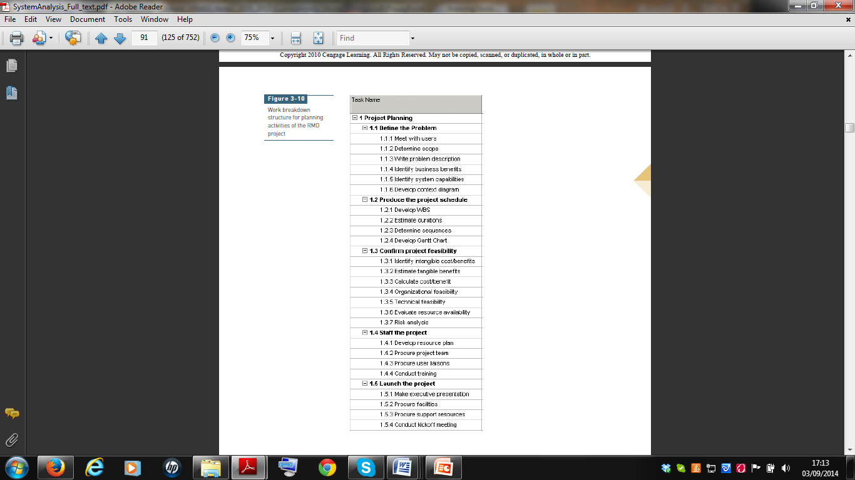
Figure 4:Work breakdown structure for planning activities of the RMO project

Slide 23
Developing a work breakdown structure cont.
There are two general approaches for building a WBS: (1) by deliverable and (2) by a sequential timeline. The first approach identifies every deliverable, both intermediate and final, that must be developed. Then the WBS identifies every task that is necessary to create that deliverable.
For example, if the project is to build a house, one of the intermediate deliverables would be to install the electrical wiring. The tasks for that deliverable relate to hiring an electrical contractor, drilling holes, running wires, connecting junction boxes, connecting fixtures, and so forth.

Slide 24
Developing a work breakdown structure cont.
The second approach—the sequential timeline approach—works through the normal sequence of activities that are required for the final deliverable. For our example of building a house, the sequential timeline approach relates to tasks such as surveying the property, digging the foundation, pouring the foundation, framing the walls, and so forth.

Slide 25
Developing a work breakdown structure cont.
The four most effective techniques for identifying the tasks of the WBS are:
Top-down: Identifying major activities first and then listing internal tasks
Bottom-up: Listing all the tasks you can think of and organizing them later
Template: Using a standard template of tasks for projects that are fairly standard
Analogy: Finding a similar, or analogous, project that is finished and copying its tasks

Slide 26
Developing a work breakdown structure cont’d
Figure 5 is an example of a work breakdown structure in a more graphical, hierarchical format.
The left side of the figure shows several levels of the WBS. The top level is the overall iteration.
Because this WBS is based on the deliverables for the iteration, the second level lists the major deliverables.
The third level denotes major activities and the fourth level contains the individual tasks.

Slide 27
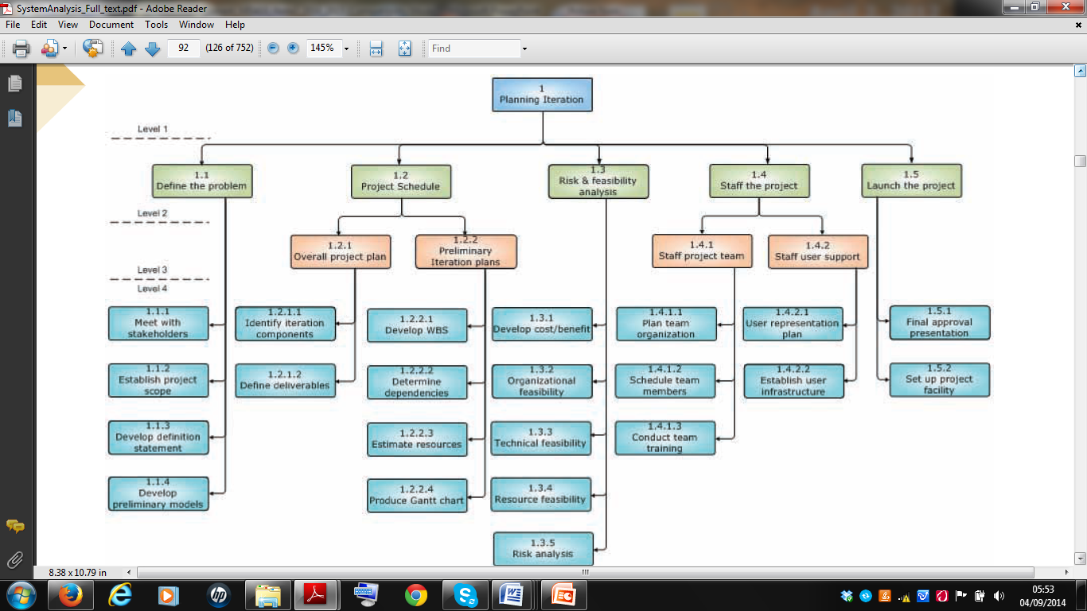
Figure 5: Work breakdown structure for the first iteration for an adaptive project for RMO

Slide 28
Developing the schedule
A project schedule lists all project activities and tasks and the order in which they must be completed.
To build the schedule, the project team must identify dependencies between the tasks on the WBS and estimate the effort that each task will require.
The first step is to identify the dependencies between the tasks—the lowest-level items on each vertical branch. Dependencies identify which tasks must be completed first or must precede other tasks. The terms used for this relationship are predecessor and successor tasks.

Slide 29
Developing the schedule cont’d
The most common way to relate tasks is to consider the order in which they are completed— that is, as one task finishes, the next one starts. This is called a finish-start relationship. Other ways to relate tasks include start-start relationships, which means that tasks start at the same time, and finish-finish relationships, which means they must finish at the same time.

Slide 30
Developing the schedule cont’d
The second step is to estimate the effort required for each task. The focus is to estimate the actual employee effort required. The effort can be in hours or days or weeks, but it should be the actual amount of work required to complete the task.
Both the dependencies and the effort are estimated on the lowest-level tasks. Once the tasks have been identified, the relationships determined, and the effort estimated, you can begin building the schedule.
Project scheduling tool such as Microsoft Project to build schedules.

Slide 31
Identifying project risks and confirming project feasibility
Project feasibility analysis is an activity that verifies whether a project can be started and successfully completed. Because, by definition, a project is a unique endeavour, every project has unique challenges that affect its feasibility.
Feasibility analysis essentially identifies all the risks of failure.

Slide 32
Identifying project risks and confirming project feasibility cont.
Generally, the team performs the following activities when confirming a project’s feasibility:
Assess the risk to the project (risk management).
Determine the organizational and cultural feasibility.
Evaluate the technological feasibility.
Determine the schedule feasibility.
Assess the resource feasibility.
Determine the economic feasibility.

Slide 33
Assessing the risks to the project (risk management)
Risk management - the project management area in which the team tries to identify potential trouble spots that could jeopardize the success of the project.
Risk management is done throughout the life of the project.
Brainstorming sessions that include key project members and stakeholders are a good way to identify risks.

Slide 34
Assessing the risks to the project (risk management) cont.
After the potential risks have been identified, the team can use a simple matrix to analyze the potential for harm to the project. Figure 6 is an example of a simple table that illustrates the technique.
The left column is the list of identified risks. The second column, provides an assessment of how badly the project will be affected if the risk materializes. The team makes a subjective judgment of three possible values: high, medium, or low.

Slide 35
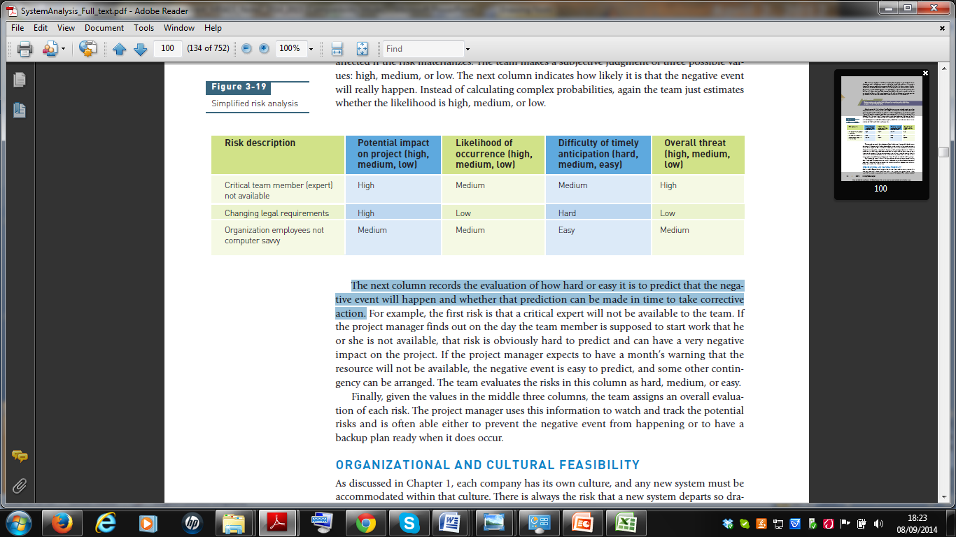
Figure 6: Simplified risk analysis

Slide 36
Assessing the risks to the project (risk management) cont.
The next column indicates how likely it is that the negative event will really happen. Again the team just estimates whether the likelihood is high, medium, or low.
The next column records the evaluation of how hard or easy it is to predict that the negative event will happen and whether that prediction can be made in time to take corrective action.

Slide 37
Organizational and cultural feasibility
Each company has its own culture, and any new system must be accommodated within that culture.
The analysts involved with feasibility analysis should evaluate organizational and cultural issues to identify potential risks for the new system. Such issues might include the following:
A current low level of computer competency
Substantial computer phobia
A perceived loss of control by staff or management
Potential shifting of political and organizational power due to the new system
Fear of change of job responsibilities
Fear of loss of employment due to increased automation
Reversal of long-standing work procedures

Slide 38
Technological feasibility
The project management team needs to assess carefully the proposed technological requirements and available expertise.
The solutions to technological risks include providing additional training, hiring consultants, or hiring more experienced employees.
In some cases, the scope and approach of the project may need to be changed to ameliorate technological risk.

Slide 39
Schedule feasibility
The development of a project schedule always involves high risk. Every schedule requires many assumptions and estimates without adequate information.
For example, the needs, and hence the scope, of the new system are not well known, the time needed to research and finalize requirements must be estimated, and the availability and capability of team members are not completely known.
One objective of defining milestones during the project schedule is to permit the project manager to assess the ongoing risk of schedule slippage. If the team begins to miss milestones, the manager can possibly implement corrective measures early. Contingency plans can be developed and carried out to reduce the risk of further slippage.

Slide 40
Resource feasibility
The project management team must also assess the availability of resources for the project. The primary resource consists of team members. Development projects require the involvement of systems analysts, system technicians, and users. Required people may not be available to the team at the necessary times.
The other resources required for a successful project include adequate computer resources, physical facilities, and support staff. Generally, these resources can be made available, but the schedule can be affected by delays in the availability of these resources.

Slide 41
Economic feasibility
Economic feasibility consists of two tests:
Is the anticipated value of the benefits greater than projected costs of development? and
Does the organization have adequate cash flow to fund the project during the development period?
A determination of the economic feasibility of the project always requires a thorough cost/benefit analysis.

Slide 42
Economic feasibility cont’d
cost/benefit analysis - the analysis to compare costs and benefits to see whether investing in the development of a new system will be beneficial.
Developing a cost/benefit analysis is a three-step process. The first step is to estimate the anticipated development and operational costs.
Development costs are those that are incurred during the development of the new system. Operational costs are those that will be incurred after the system is put into production.

Slide 43
Economic feasibility cont’d
The second step is to estimate the anticipated financial benefits. Financial benefits are the expected annual savings or increases in revenue derived from the installation of the new system.
The third step, the cost/benefit analysis step, is calculated from the detailed estimates of costs and benefits.

Slide 44
Economic feasibility cont.
Development Costs
Although the project manager has final responsibility for estimating the costs of development, senior-level analysts always assist with the calculations. Generally, project costs come in the following categories:
Salaries and wages
Equipment and installation
Software and licenses
Consulting fees and payments to third parties
Training
Facilities
Utilities and tools
Support staff
Travel and miscellaneous

Slide 45
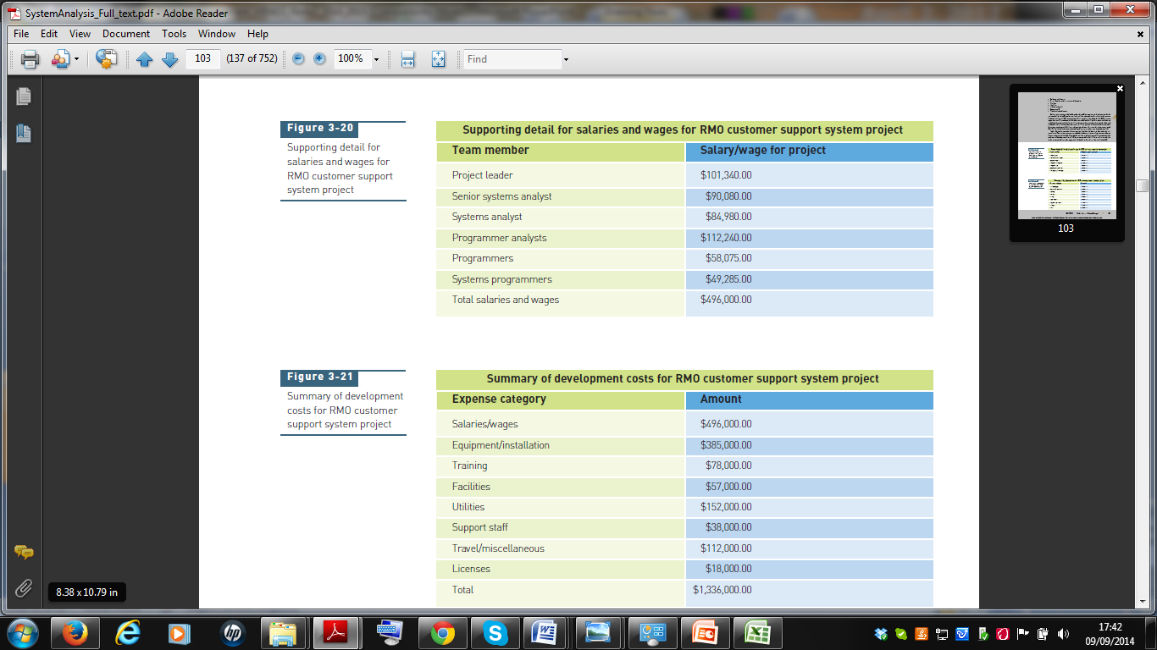
Figure 7: Supporting details and summary of development costs for RMO customer support system project

Slide 46
Economic feasibility cont.
Sources of Ongoing Costs of Operations
After the new system is up and running, normal operating costs are incurred every year. The calculation of the cost and benefit of the new system must also account for these annual operating costs.
Only the costs that are directly related to the new system and its maintenance are included.

Slide 47
Economic feasibility cont’d
The following list identifies the major categories of costs that might be allocated to the operation of the new system:
Connectivity
Equipment maintenance
Costs to upgrade software licenses
Computer operations
Programming support
Amortization of equipment
Training and ongoing assistance (the help desk)
Supplies

Slide 48
Economic feasibility cont’d
Sources of Benefits
The project manager and members of the project team can determine most of the development and operational costs. However, the user and the client receive the benefits of the system.
Consequently, the client and the user must determine the value of the anticipated benefits.
Benefits usually come from two major sources: decreased costs or increased revenues. Cost savings or decreases in expenses come from increased efficiency in company operations.

Slide 49
Economic feasibility cont’d
Areas in which to look for reduced costs include the following:
Reducing staff by automating manual functions or increasing efficiency
Maintaining constant staff with increasing volumes of work
Decreasing operating expenses
Reducing error rates through automated editing or validation
Achieving quicker processing and turnaround of documents or transactions
Capturing lost discounts on money management
Reducing bad accounts or bad credit losses
Reducing inventory or merchandise losses through tighter controls
Collecting receivables (accounts receivable) more rapidly

Slide 50
Economic feasibility cont’d
tangible benefits - benefits that can be measured or estimated in terms of dollars and that accrue to the organization.
Intangible benefits - benefits that accrue to the organization but that cannot be measured quantitatively or estimated accurately

Slide 51
Economic feasibility cont’d
Examples of intangible benefits include the following:
Increased levels of service (in ways that cannot be measured in dollars)
Increased customer satisfaction (not measurable in dollars)
Survival (a standard capability common in the industry, or common to many competitors)
Need to develop in-house expertise (such as with a pilot program with new technology)
Examples of intangible costs include the following:
Reduced employee morale
Lost productivity (the organization may not be able to estimate it)
Lost customers or sales (during some unknown period of time)

Slide 52
Staffing and launching the project
The responsibility for staffing the project team falls primarily on the project manager. This includes finding the right people with the correct skills and then organizing and managing them throughout the project.
The staffing activity consists of five tasks:
Develop a resource plan for the project.
Identify and request specific technical staff.
Identify and request specific user staff.
Organize the project team into workgroups.
Conduct preliminary training and team-building exercises.

Slide 53
Staffing and launching the project Cont’d
The key question to be answered when completing the staffing activity is: Are the resources available, trained, and ready to start the project?
After the previous project planning activities are complete, it is time to launch the project. The scope of the new system is defined, the risks have been identified, the project has been found feasible both economically and otherwise, a detailed schedule has been developed, team members have been identified and are ready, and it is now time to start.

Slide 54
Staffing and launching the project Cont’d
Two final tasks usually occur at this point. First, the membership of the oversight committee is finalized, and it meets to give final go-ahead for the project, including releasing the necessary funds.
Second, the organization makes a formal announcement through its standard communication channels that gives credence to the project and solicits cooperation from all involved parties in the organization.

Slide 55
Staffing and launching the project Cont’d
In other words, the project gets the blessing and visible support of the organization’s senior executives. No project should begin without these two events. The key question to be answered when launching the project is: Are we ready to start the project?

Slide 56
Review Questions
List and explain the activities of project planning.
List the seven reasons projects fail.
List the five reasons projects are successful.
What are three reasons projects are initiated?
Define project management.
Describe the six types of feasibility used to evaluate a project.
What is the purpose of the cost/benefit analysis used to assess economic feasibility?

Slide 57
Review Questions Cont’d
Explain the difference between tangible and intangible costs and benefits. Which are ignored in cost/benefit analyses?
List at least five possible sources of tangible benefits from the installation of a new system.

